Slide 1
An In-depth Study of Commercial MVNO: Measurement and Optimization
Ao Xiao, Yunhao Liu, Yang Li, Feng Qian,
Zhenhua Li, Sen Bai, Yao Liu, Tianyin Xu, Xianlong Xin
Notes:
Thanks for the introduction. Hello everyone, I am Ao Xiao, come from Tsinghua university. Our work is an in-depth study of commercial Mobile Virtual Network Operator: measurement and optimization.

Slide 2
Dread of Base Carriers
Poor service quality!
Monopoly→
Price up
I still want more customers, which now seems too hard …
Alice
Bob
MNO (Mobile Network Operator)
Notes:
Nowadays, almost everyone has a cellphone. And each one of the cellphone has at least one sim card of base carrier. Here I want to ask you a question: what are your fears about base carriers? Since only several base carriers in a country typically own legal licenses to exclusively use certain frequencies of the radio spectrum, some people are like Bob. They worry about the telecommunication market monopoly. If all the base carriers in your country raise prices, you have no choice but to accept it. Some other people, like Alice, are concerned about the service quality of base carriers because there are only several base carriers in one country and they have little commercial competition. From the base carrier’s perspective, they still want more customers which now seems too hard.

Slide 3
Emergence of MVNO
Mobile Virtual
Network Operator
Notes:
So, in order to improve those problems. Mobile virtual network operators have emerged. We also call them MVNOs. For example, Lycamobile. Founded in 2006, Provides low-cost high-quality international calls to over 15 million customers across 22 countries. And in the US, Tracfone is the representative of Virtual Operators. Another example is Virgin Mobile which is a wireless communications brand used by eight independent brand-licensees worldwide. You can use their Sim cards, but they don’t have their own radio infrastructures. Virtual operators fully or partially leverage one or multiple base carriers’ licensed radio spectrum and facilities. In China, virtual operators have emerged for only several years. There are Xiaomi Mobile, Snail Mobile, Suning Mobile and so on.

Slide 4
Why MVNOs?
Offer cheaper or more ﬂexible data plans
Promote the competition in telecom market
Enhance the utilization of base carriers’ infrastructures
Bring the base carriers more customers
Notes:
Then you may be curious about the specific benefits that virtual operators bring to us. So am I. We make some research to understand why virtual operators? Here we have four reasons. First, virtual operators offer cheaper and more flexible data plans than base carriers. Second, virtual operators can promote the competition in telecommunication market.
Third, they can enhance the utilization of base carriers’ infrastructures. Finally, virtual operators bring the base carriers more customers.

Slide 5
MVNO Customers’ Concerns
Potential overcharge problems
Inferior network performance
Cost more?
Lower speed?
Alice
Bob
Notes:
Although virtual operators bring a lot of conveniences to our life. Virtual operators customers still have some concerns. After checking about 12,000 posts from the xiaomi Mobile’s BBS users, we find that they are mainly bothered by potential overcharge problems and worry about inferior network performance.

Slide 6
Virtual Operators’ Concerns
Making money is easy!
Yes
Wholesale
Price
No
How to make money?
Notes:
Also, from an virtual operator’s perspective, it offers cheaper price than base carriers. Hence, there is a question: How does it make money? For some virtual operators, they can get low wholesale prices from their base carriers by business negotiations. However, there are some other virtual operators. Their base carriers don’t give them the wholesale price. Such as in China, virtual operators cannot get the wholesale prices.

Slide 7
Addressing the Concerns:
A Case Study
Xiaomi Mobile
https://www.mi.com/mimobile/
Founded in 2015.09
Over one million customers
Work on top of China Telecom
A major base carrier in China
Notes:
So here we focus on Xiaomi Mobile which is a representative virtual operator in China. Xiaomi Mobile was founded in September 2015. It has about 1 million customers up to October 2017. Xiaomi Mobile’s base carrier is China Telecom which is one of the three biggest mobile network operators in China. We made a nearly two-year measurement study towards understanding various key aspects of the virtual operator ecosystem, including its architecture, performance, economics, customers, and the complex interplay with the base carrier.

Slide 8
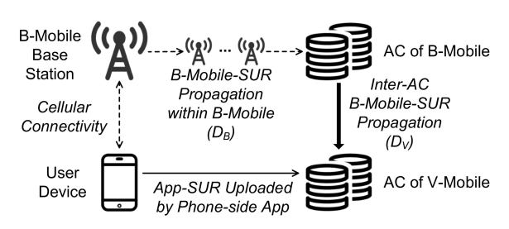
System Architecture
V-Mobile: Xiaomi Mobile
B-Mobile: China Telecom
AC: Accounting Center
SUR: State Update Report
Notes:
This is a picture of the interactions among Xiaomi mobile, its customers and china telecom. Here we use V-Mobile, B-Mobile and SUR instead of Xiaomi Mobile, China Telecom and state update report for convenience in the picture. In the upper branch, Per the agreement between xiaomi Mobile and its base carrier, they establish a control-plane channel between their accounting centers, allowing the base carrier to forward xiaomi Mobile users’ state update reports, which we call B-Mobile-SURs, to xiaomi mobile. In the base carrier, B-Mobile-SURs are gathered and propagated by its base stations. Another way of delivering sate update reports is illustrated in the bottom branch. Xaiomi Mobile customers can optionally install an App developed by xiaomi Mobile. When the app is running, It keeps monitoring the client device’s data usage and uploading state update reports, which we call App-SURs, directly to xiaomi Mobile’s accounting center.

Slide 9
Five Datasets
http://bbs.xiaomi.cn/
1. BBSDataset:
12,000 posts from users’ BBS
2. UserDataset
Gender
3. Monthly Dataset
Monthly data plan
4. PerfDataset
RTT
5. SURDataset
Birthday
Date of join
Date of leave
Data usage
Payment
Account balance
Flow duration
Flow size
…
…
B-Mobile-SURs
V-Mobile-SURs
Notes:
To enable our largescale measurement, we collect five datasets:
BBSDataset, which consists of about 12,000 posts from the Bulletin Board System maintained by xiaomi Mobile ;
UserDataset, which includes all customers’ basic information, such as the gender, birthday, and the date of joining and leaving xiaomi Mobile;
MonthlyDataset, which refers to each user’s monthly data plan, payment, data usage, and account balance information;
PerfDataset, which comprises the network performance statistics of 342 xiaomi-Mobile users and 250 china telecom users who opted in to help us collect detailed network performance data;
SURDatsset, which is the set of two types of state update reports that are collected from xiaomi Mobile’s accounting center.

Slide 10
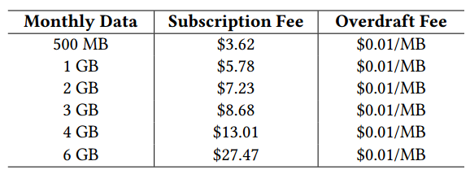
Data Usage Characterization
Users can save a small portion of money
MVNO users are quite price conscious
Xiaomi Mobile
Base Carrier
Notes:
Next, we analyze those datasets and have some findings. Two tables here compare the specific data plans offered by both carriers, from which we find that xiaomi Mobile customers can indeed save a portion which is ranging from 1.1% to 2.4% of money. Although the economic incentives seem weak, there are still about one million customers.
It indicates that virtual operator users are quite price conscious.

Slide 11
Data Usage Characterization
Women users take the majority
Most users are younger than 30
Most 4GB plans: 30~39 years old
Notes:
Here are another findings about virtual operators. The picture on the left is the relationship between gender and data plan selection. We find that women users take the majority. This is in line with a recent study showing females tend to be heavier smartphone users compared to Males. Regarding the age distribution, as shown in the figure on the right, most of xiaomi Mobile customers are younger than 30, with the exception where the 4 GB data plan holders are dominated by people between 30 and 39 who are presumably more financially sound. From 2016 to 2017, the ratio of users younger than 30 increased by 1.7% .

Slide 12
Data Usage Characterization
82.59%
Most Users under-utilize their data plans!
So the virtual operator can take advantage of this to make money
Notes:
Furthermore, here are two pictures about the relationship between users’ selected data plan and users’ monthly actual usage. Both of them indicate that customers typically under-utilize their data plans, most users are conservative with their data usage. So that’s the key point that virtual operators can take advantage of it to make profits.

Slide 13
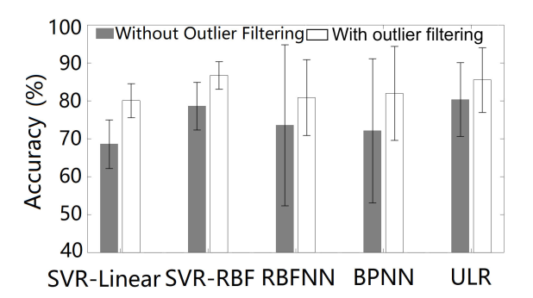
Data Usage Prediction
Accuracy: 86.75%
Notes:
In order to help virtual operators to make more profits, the first step is to predict each user’s data usage. Moreover, this step can also enable numerous use cases such as data plan recommendation, cellular infrastructure planning, and cost-aware content prefetching and so on. Here, we use five different machine learning methods to predict each user’s data usage. And choose the method which is using SVR with RBF kernel with outlier filtering. It achieves an overall prediction accuracy of up to 86.75% across users.

Slide 14
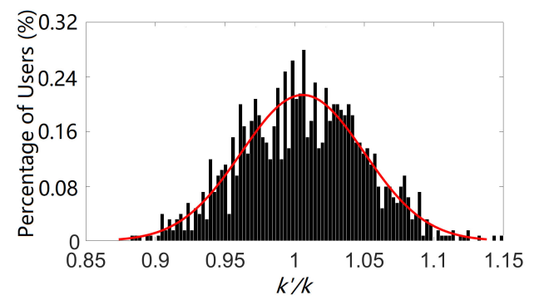
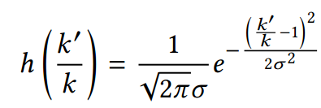
Data Reselling
Data Prediction
Statistical Uncertainty Modeling
Data Reselling Optimization
Notes:
Then we use the statistical uncertainty modeling to improve the result of data prediction. In particular, for users with a short lifetime, their data usage prediction is inherently difficult due to a lack of training samples. So it’s important to perform uncertainty modeling. Then, Recall that a virtual operator user oftentimes doesn’t use up her subscribed data plan, so the virtual operator can purchase an inferior plan from base carrier to fulfill it, and utilize the price diﬀerence to make profits. Our goal here is to make the selection of the fulfill plan more intelligent, in order to increase the profit for the virtual operator.

Slide 15
How does It Work?
The Current Approach: 3.5%
Machine Learning Only: 4.1%
Machine Learning with Uncertainty Estimation: 5.5%
Our Methods
The Optimum: 6.2%
Notes:
After those complicated steps to optimize the data reselling. It looks good in theory. But how does it work? To assess the eﬀectiveness of the method, we apply it to the historical usage data of xiaomi-Mobile users between January 2016 and October 2017 to optimize the reselling profit for the billing cycle of November 2017. there is a key evaluation metric here, A higher Profit Rate is always preferred by xiaomi-Mobile. We compare four optimization methods, obviously the third one makes the highest profit rate. And the profit rate of the optimum is only 12.7% higher than our method’s profit rate.

Slide 16
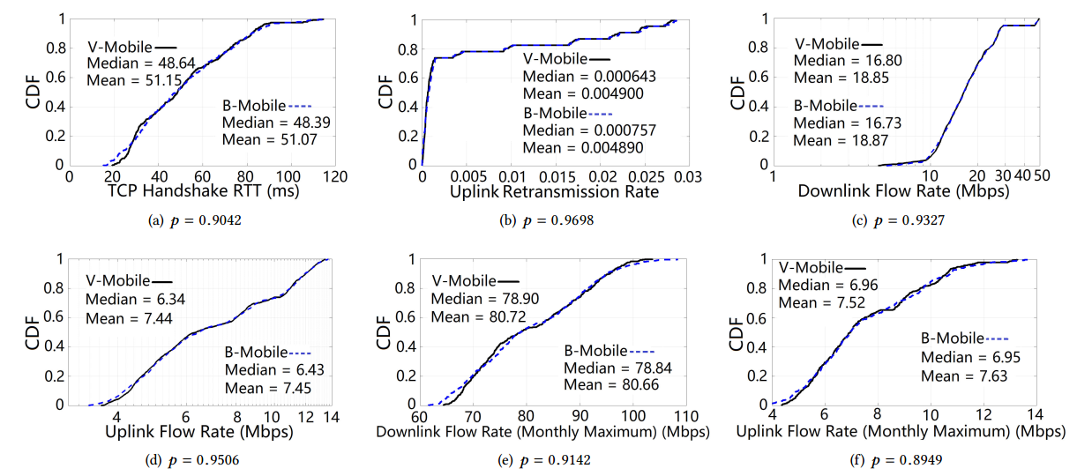
Network Performance
No noticeable performance diﬀerence between MVNO and MNO
Performance degradation is not a necessity
Notes:
Since virtual operators provide flexible services with low prices. Some people have doubt that do virtual operators provide worse network performances than their base carriers. So here we make an measurement and analyze those data, surprisingly, we find that there is no noticeable network performance difference between xiaomi-Mobile and its base carrier. This is distinct from previous reports where virtual operator users may suﬀer from performance degradations compared to the base carrier users. Our results indicate that the performance degradation reported by prior studies is very likely a policy-level result by the base carrier rather than a technical necessity.

Slide 17
Customer Churn of MVNOs
Expense
New Customers
Old Customers
MVNO
Notes:
From an virtual operator’s perspective, there is a problem which we cannot ignore. If virtual operators want to seizing the market, they should pay more attention to customer churn because of the high expense that a carrier needs to recruit new customers.

Slide 18
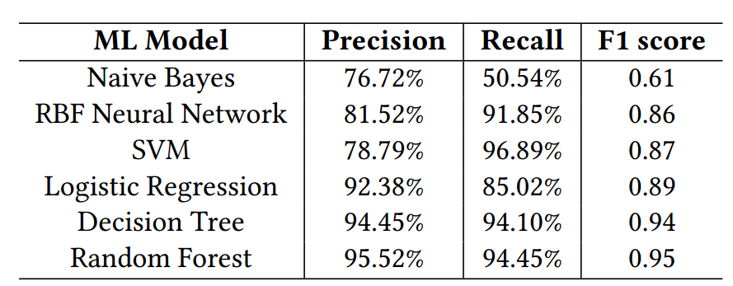
Customer Churn Prediction
Notes:
In order to mitigate the customer churn of virtual operators, we use 6 machine learning methods to predict the customer churn. Then we evaluate the prediction accuracy using 10-fold cross validation based on users. Here are the results. And this table indicates that the random forest model outperforms the others. And it achieves 95.52% precision and 94.45% recall.

Slide 19
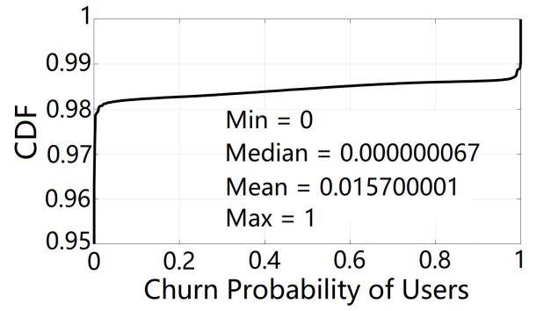
Real-world Churn Mitigation
Send digital gift cards
0.83% 0.32%
Before
After
Notes:
Since the method has good results. How about use it in the real world? So We conduct a field trial for churn mitigation in late October 2017 by collaborating with xiaomi Mobile. This is the result of it. The dropout probability exhibits a bimodal distribution where nearly 98% of the users have a churn probability near zero and 1% of the users have a churn probability near 1. we select the top 1% of the users with the highest dropout probability, and recommend xiaomi Mobile send to each of them a digital gift card containing a small amount ($1.44) of top-up fee and the gift card can only be activated next month. After conducting this churn mitigation campaign, xiaomi Mobile observed that the churn rate decreased significantly from 0.83% in October 2017 to 0.32% in November 2017. This indicates the potential eﬀectiveness of our churn prediction approach.

Slide 20
Inaccurate Billing in MVNOs
Issue 1: Termination of service despite a positive account balance.
Issue 2: Unexpectedly high monthly charge experienced by customers.
Issue 3: Unexpectedly high charge experienced by MVNOs.
Notes:
About the inaccurate billing in virtual operators. There are 3 key issues: XXX

Slide 21
Inaccurate Billing in MVNOs
Notes:
To understand the root causes of the above issues, we carefully analyze the state update report dataset. Because these issues are mainly caused by the state update propagation delay, inter-accounting centers delay or both of them. Here, we can see that state update propagation delay ranges from several seconds to 2 and a half hours, and averages at nearly 16 minutes. The delay between two accounting centers ranges from 1 second to 4.3 minutes, with an average of around 2 minutes.

Slide 22
Inaccurate Billing in MVNOs
Issue 2:${ D}_{B}+D_{V}$
Issue 1: $D_{V},$Issue 3: $D_{V}$
Notes:
For issue one: at the time when the cellular service was terminated by the virtual operator, the user’s account balance had indeed decreased to zero or negative at base carrier’s accounting center. However, the B-Mobile-SUR had not yet been propagated to xiaomi Mobile’s accounting center due to the high delay between them.
For Issue two: at the end of the previous month, due to the high propagation delay (DB + DV ), a small portion of the B-Mobile-SURs arrived late at xiaomi Mobile’s accounting center. So xiaomi Mobile was not able to add them to the previous month’s bill. Instead, they were then added to the current month’s bill, making it look unreasonable.
For the final issue: we owe it to the excessive delay (DV ) between two accounting centers. Specifically, after a xiaomi Mobile’s user switches to a diﬀerent data plan, the subscription is not always delivered from xiaomi Mobile’s accounting center its base carrier’s accounting center in real time when the inter-accounting center channel is congested. As a result, before the new data plan actually takes eﬀect at base carrier, the user’s subscription will experience inconsistency between xiaomi Mobile and its base carrier. This inconsistency will be reflected on the next bill that base carrier sends to xiaomi Mobile.

Slide 23
Summary
An in-depth study of Xiaomi Mobile, a large and representative MVNO with 1 million customers
Data Plan and Usage Characterization
Network Performance Characterization
Data Reselling Optimization
Customer Churn Profiling and Mitigation
Understanding Inaccurate Billing Issues
Notes:
Finally, I want to make a summary of our work.
In general, we conduct XXX.
Our work include XXX.
(单击)that’s all，thank you.
---------
测量：Collect performance data:We take a crowd-sourcing-based approach where we invite users of both V-Mobile and B-Mobile to voluntarily participate in a data collection campaign by installing an app developed by V-Mobile and turning on the “sampling performance” option for a whole month. The app we leverage for the campaign only works on Android (not iOS), so it is likely to introduce some bias to the measurement results. The app passively measures key performance metrics such as RTT and throughput of users’ traffic.1TB data, 30days.
便宜的少，有其他好处：V-Mobile also provides “soft” value-added services to its customers in terms of billing, state update, customer service, and so on. Furthermore, V-Mobile can operate on more than one base carrier and is expected to support the cross-carrier portability of users’ phone numbers in the near future
微积分：use calculus，discrete, continuous.

